Slide 1
2024 PHM Conference Tutorial
Probabilistic Deep Learning
Dr. Jesse Williams
GTC Analytics, CTO/VP of Digital Engineering
Actionable Intelligence through Analytics

Slide 2
Tutorial Overview
About me
Multi-model machine learning
Multi-model deep learning
Maskensemble deep learning
Application to the 2024 Data Challenge
Extra: TensorFlow Probability

Slide 3
Probabilistic Estimation of Seismic Response Using Physics-Informed Recurrent Neural Networks
Idaho National Laboratory
Georgia Tech
Deep Learning Probabilistic Regression for Onset Time Determination
AFTAC
Stanford
SIREN: Seismic & Infrasound Intelligence for Rocket-Launch Event Notification
US Space Force
Machine Intelligence for Nuclear Explosion Monitoring
Applied Research Associates
Machine Learning Methods to Catalog Source from Diverse, Widely Distributed Sensor
AFRL
Georgia Tech
RaNDL: Rapid Nuclear and seismic events Discriminator and Locator
AFRL
Georgia Tech
MobiQkRad – Real Time Source Localization with Contextual Information
DHS
Decentralized Data Fusion Algorithm for Multisensor Radiation Source Search
DTRA
Oak Ridge National Laboratory
Model-Based Enterprise Architecture for Institutional Management Digital Twins
NASA
Georgia Tech
Enabling Digital Metrology and Manufacturing Through the Model-Based Enterprise
NAVAIR
University of Georgia
Digital Twin Technologies to Improve Mission Readiness and Sustainment
NAVAIR
Vanderbilt
ARADISS: Adaptive Real-time Anomaly Detection & Identification for Space Systems
NASA
University of Colorado, Boulder
Real Time Cybersecurity Systems for Safety Critical Military Vehicle Applications
US Army
University of Michigan
TRAIT: Transition-pipeline Recommender & Attrition Identification Tool
NAVAIR
Georgia Tech
US Navy Postgraduation School
Advanced Analysis of Nuclear Waste Storage Cask Health
Virginia Tech
TRACAIR: TRAjectory Course analyzer and Anomaly IdentifieR
NASA
Georgia Tech
Seismic AI in RealTime for Informed Drilling and Fracking
DOE
Georgia Tech
Operation-Aware ISHM for Environmental Control and Life Support in Deep Space Habitants
NASA
University of South Carolina
Resource Management Strategies for a Resilient Habitat Advanced Life Support (ALS) System
NASA
Georgia Tech

Slide 4
Probabilistic DL Basic Concepts
Ensemble method
Many models each with their own
History/beliefs
When inference is “easy”
Models predict similar estimation
When inference is “hard”
Model predictions diverge
Inference confidence can be correlated to
Predict standard distribution

Slide 5
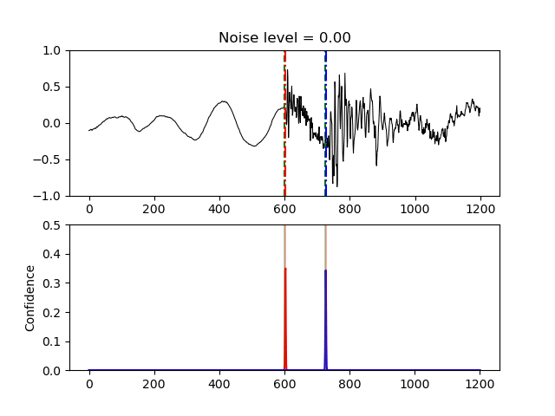
Probabilistic DL Basic Concepts

Slide 6
Tutorial Resources
https://github.com/globaltechinc/probablistic_deep_learning

Slide 7
Technology Review

Slide 8
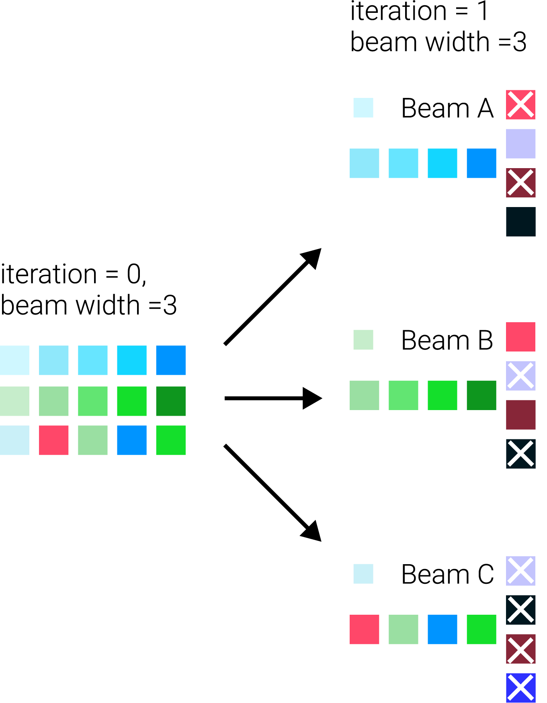
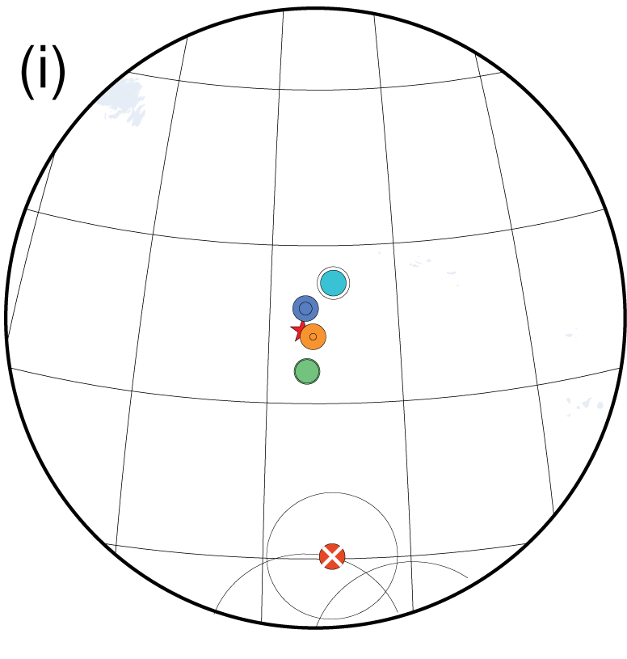
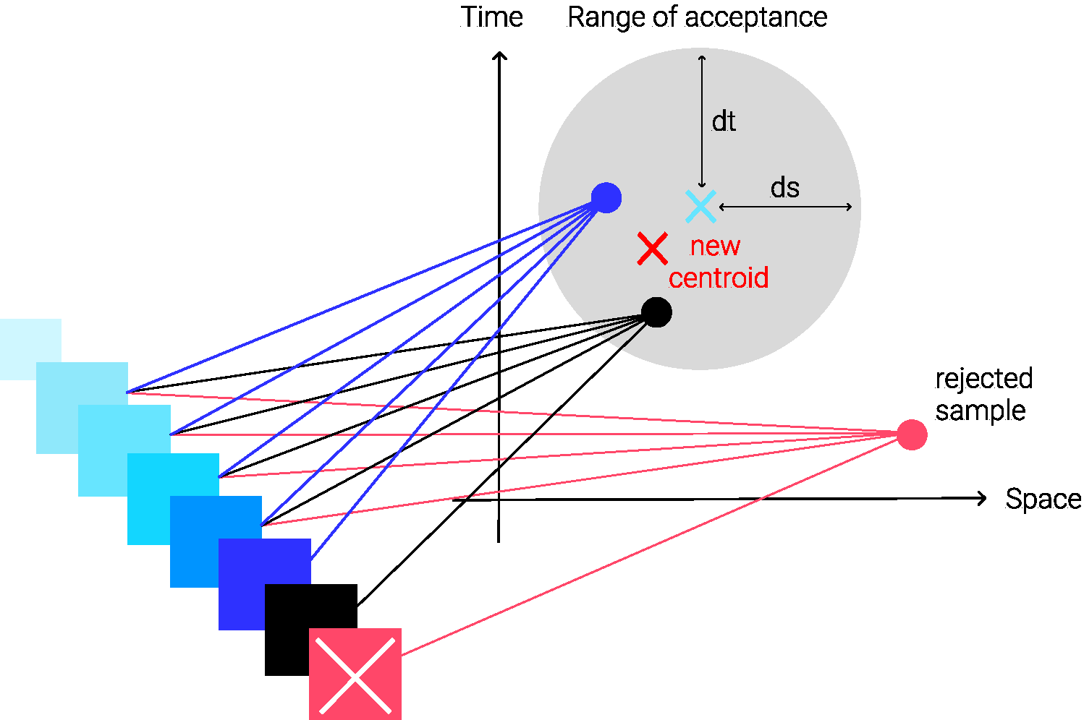
Technology Review
Beam Search: Origin Refinement

Slide 9
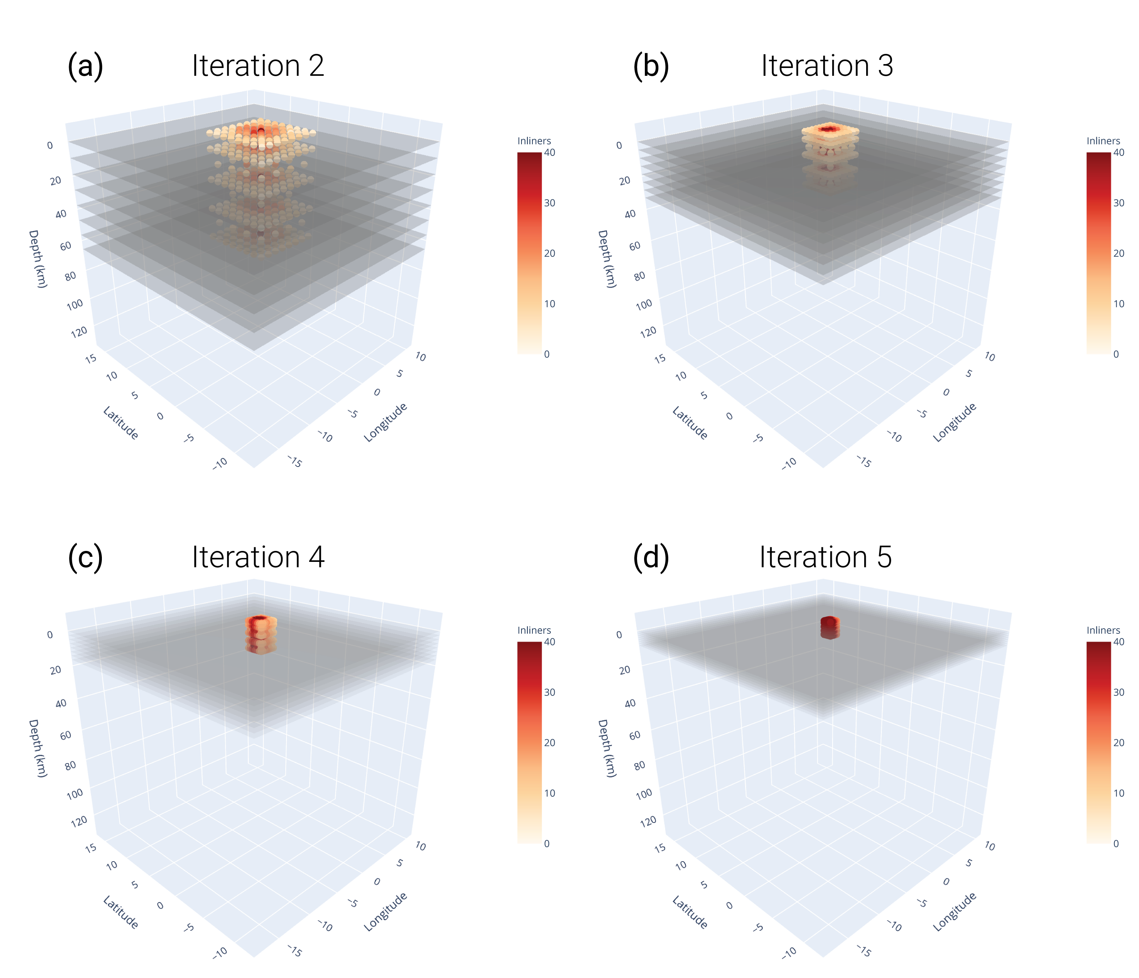
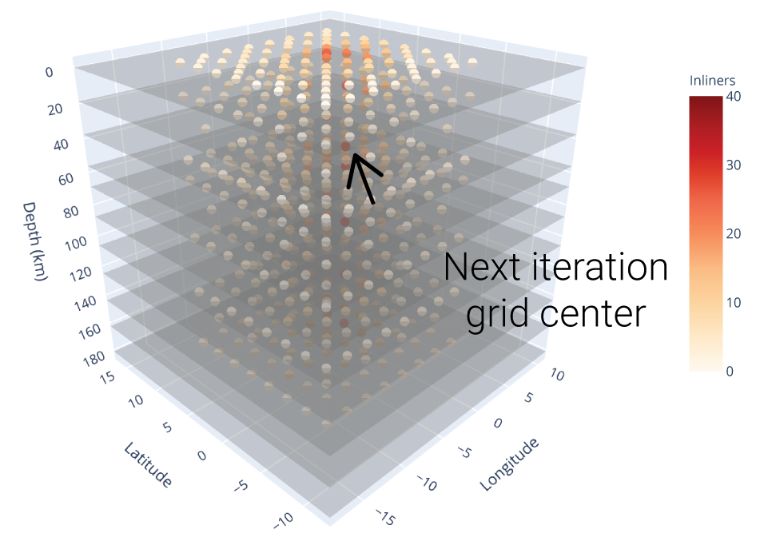
Technology Review
Octree: Final Association and Event Location

Slide 10
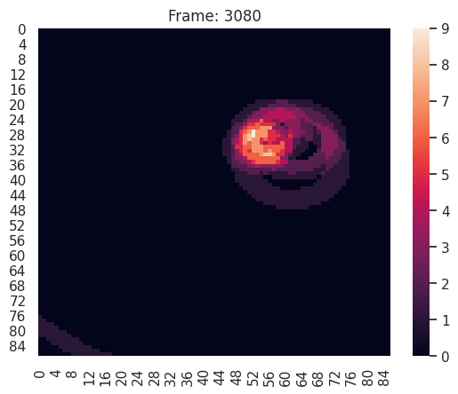
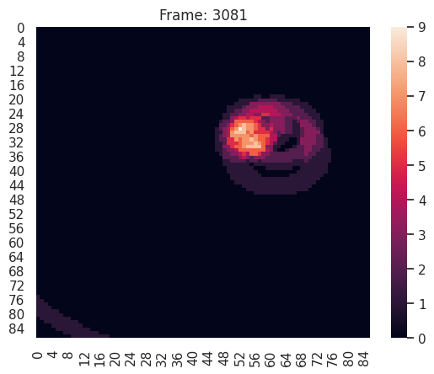

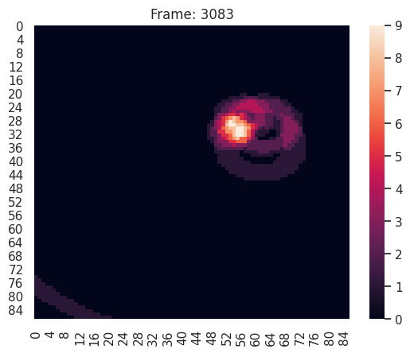
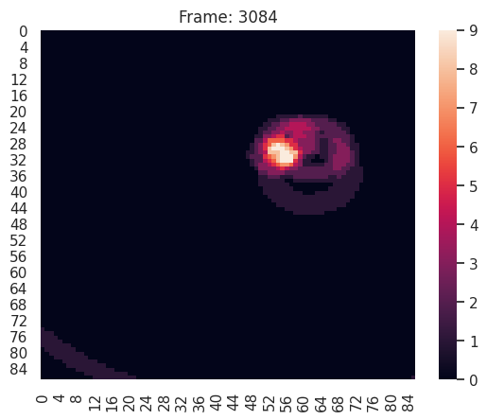


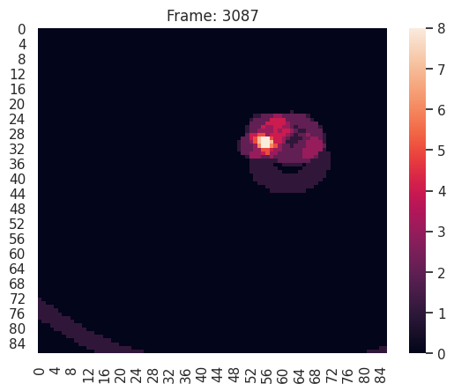
Technology Review
Octree: Final Association and Event Location

Slide 11
Technology Review
Benchmarking/Metrics
Using only P-wave arrivals
Event size (LEB) | Metrics | SEL3 (GA) | RaNDL
# phases < 50 | Average event split | 1.11 | 1.54
 | % of phases the best event retained | 0.72 | 0.64
# phases >= 50 | Average event split | 2.67 | 2.67
 | % of phases the best event retained | 0.61 | 0.77

Slide 12
Proposed Work
Overall Objectives
Flexibly incorporate other features
Raise technology readiness level (TRL)
Tasks
Improve Dynamic Multi-net Locator (DML)
Build NLP optimization for the DML
Improve framework and create on-demand grid search
Refine testbed protocols and metrics

Slide 13
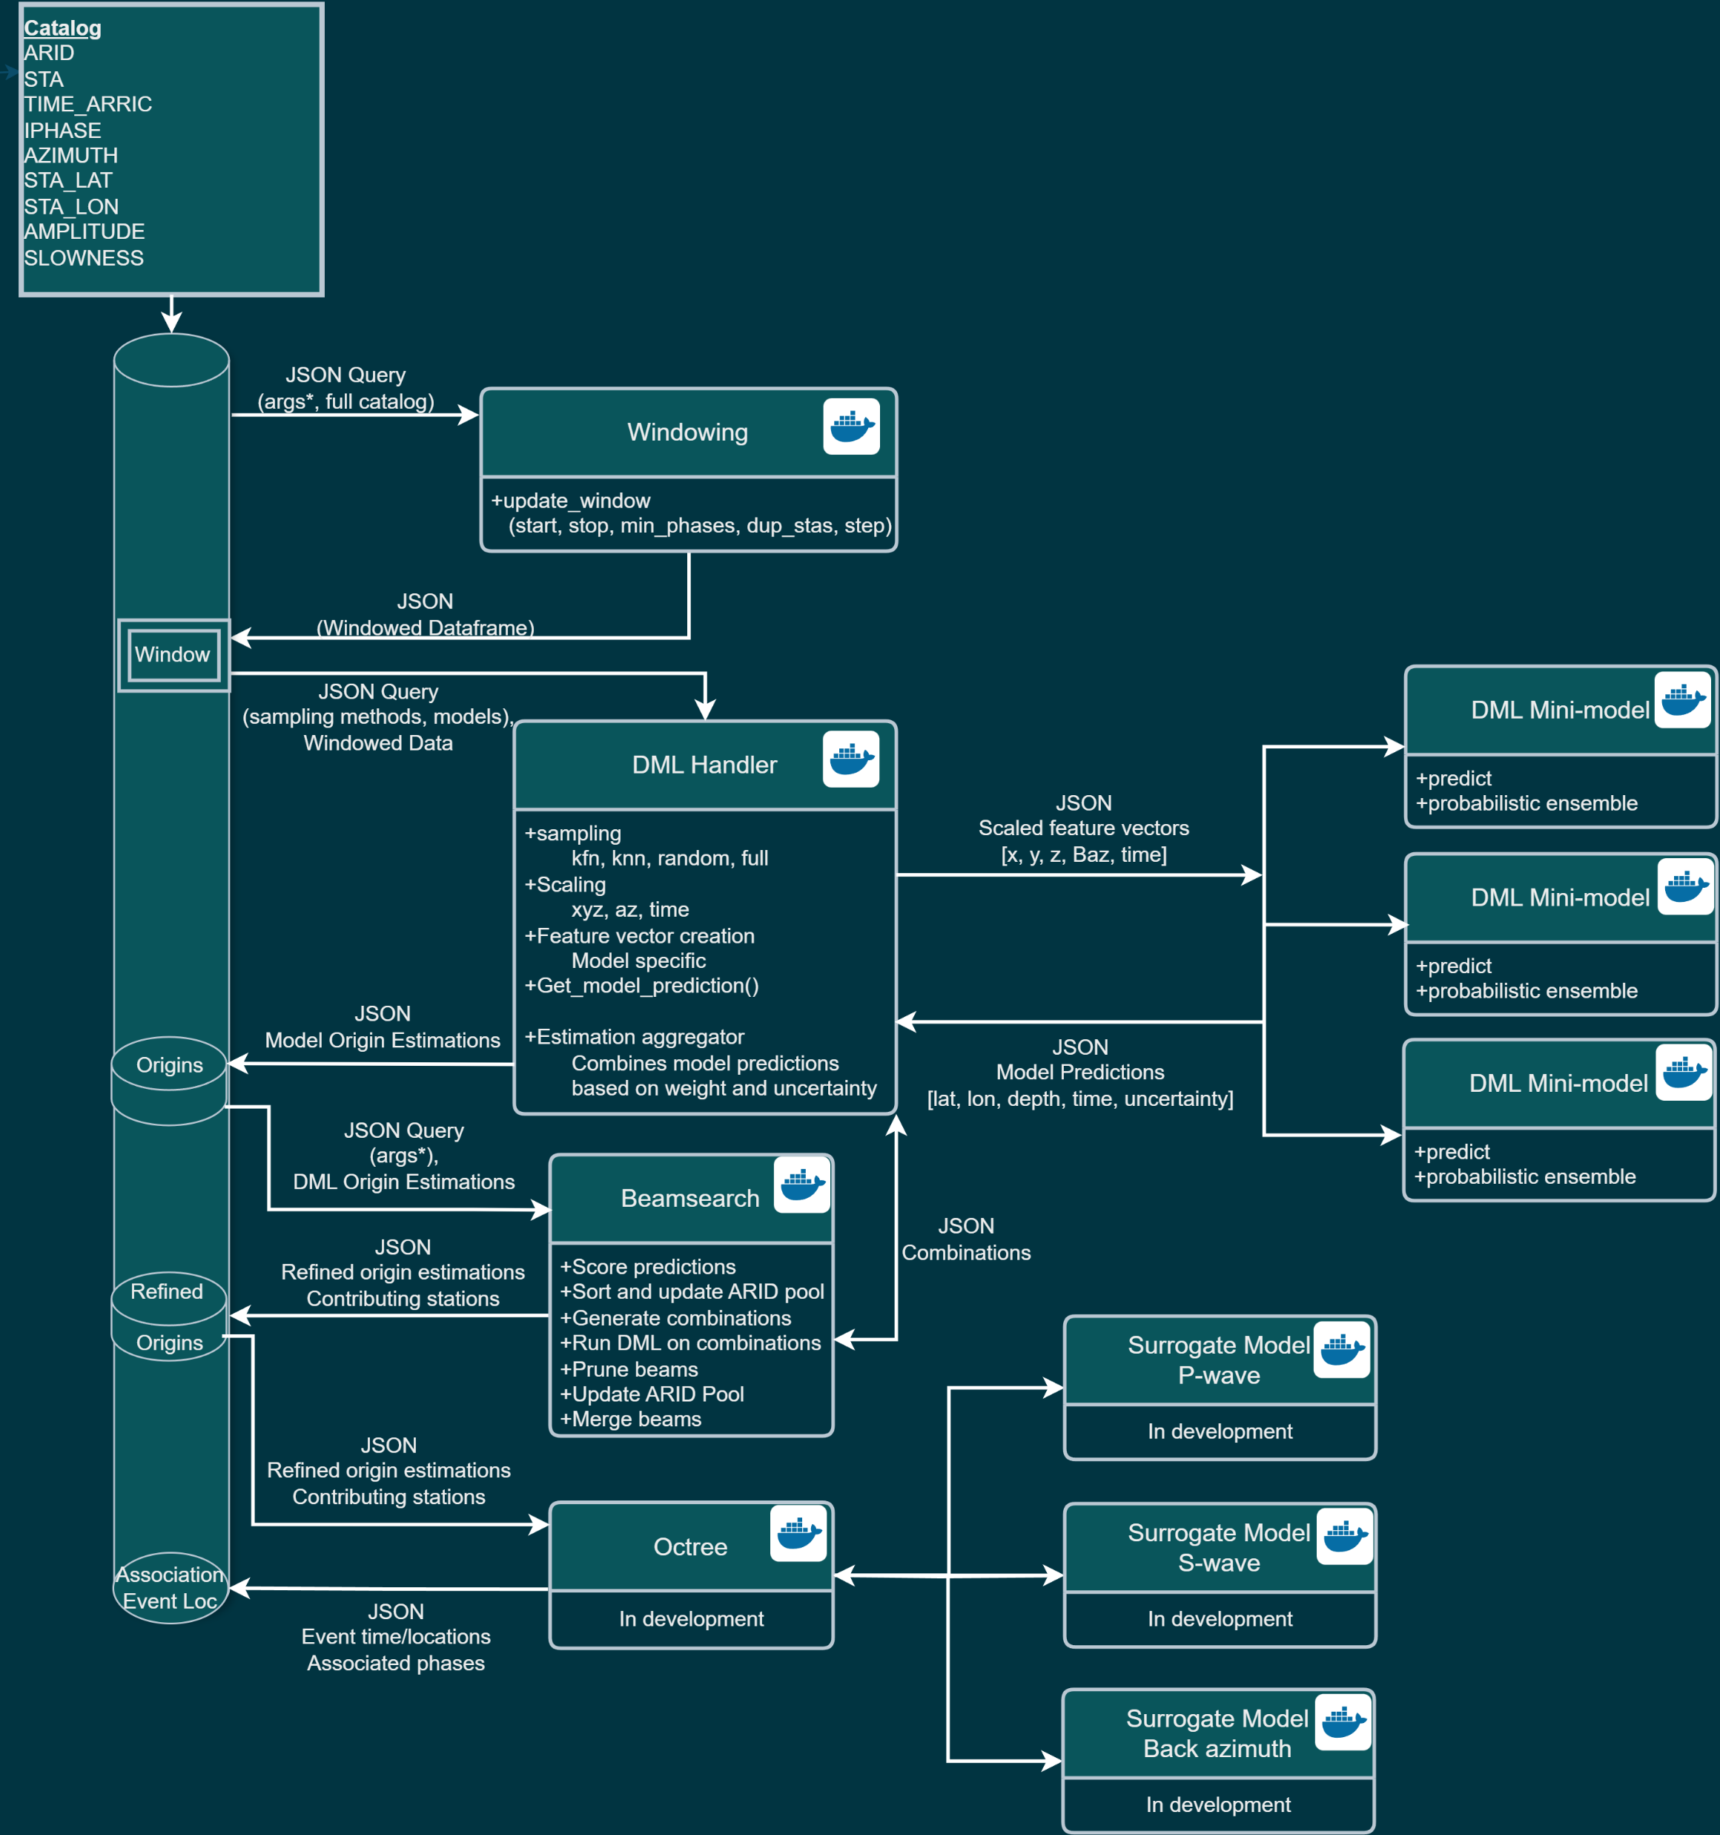
Flexible Architecture
Overall Objectives
Containerized modules
Web service
Independently updateable
Combine modules at will to test/use
Flexible feature use
Can use any combination of features
Use of “new” features means updating module but not whole process
Weights to assign relative importance

Slide 14
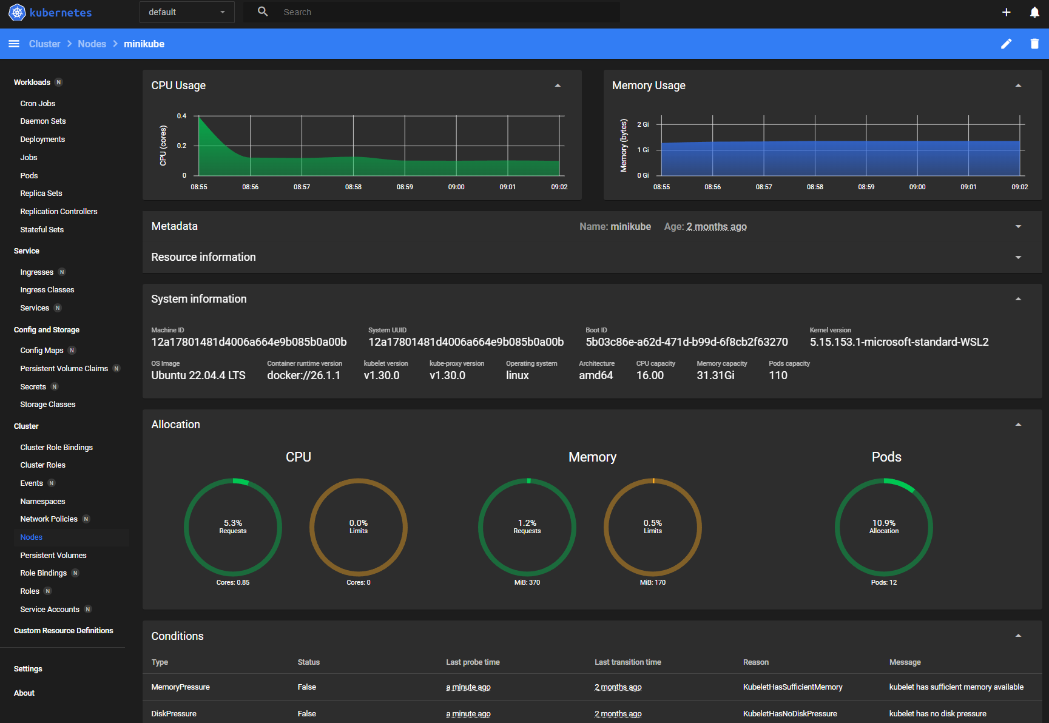
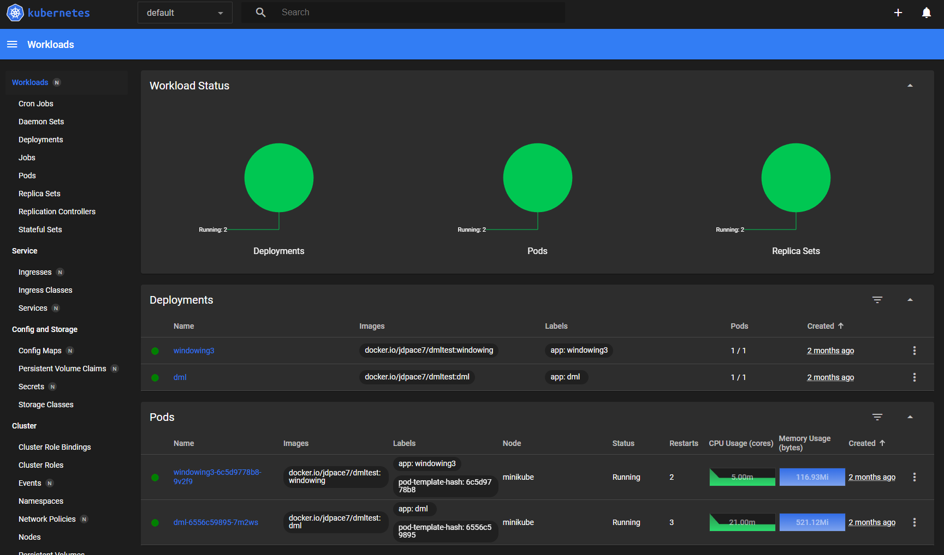
Flexible Architecture
Docker Management with Kubernetes

Slide 15
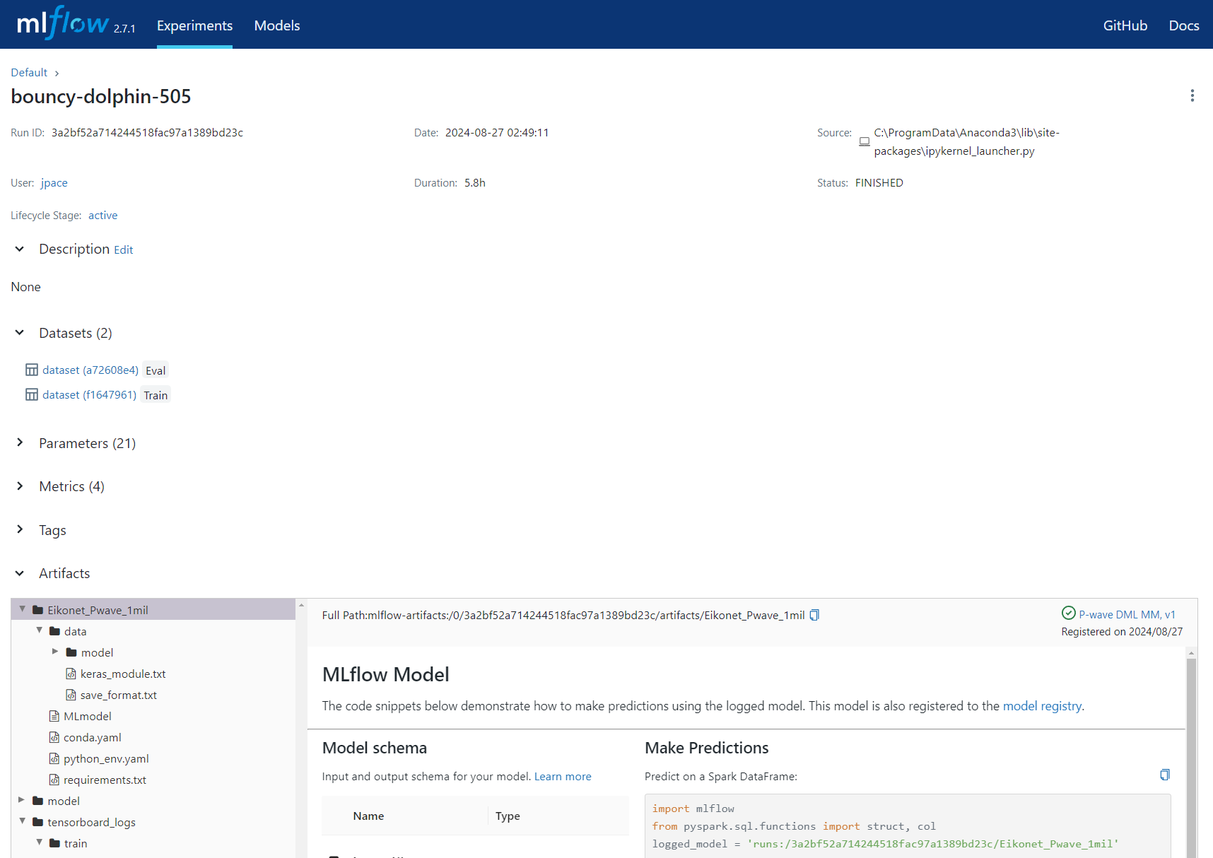
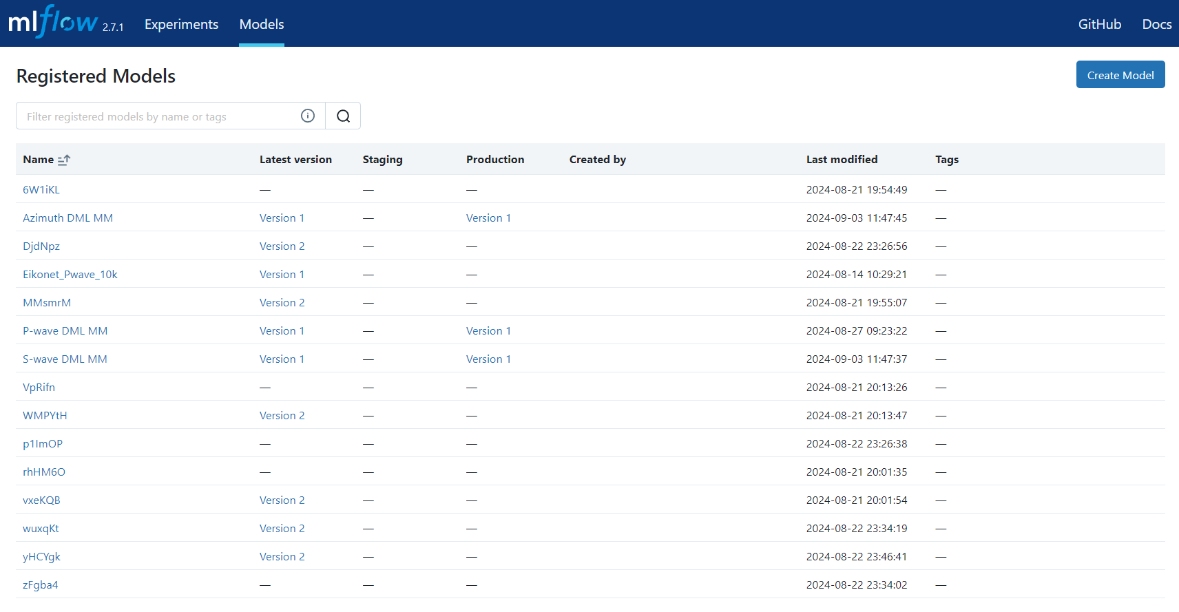
Flexible Architecture
DL Model Management with MLflow

Slide 16
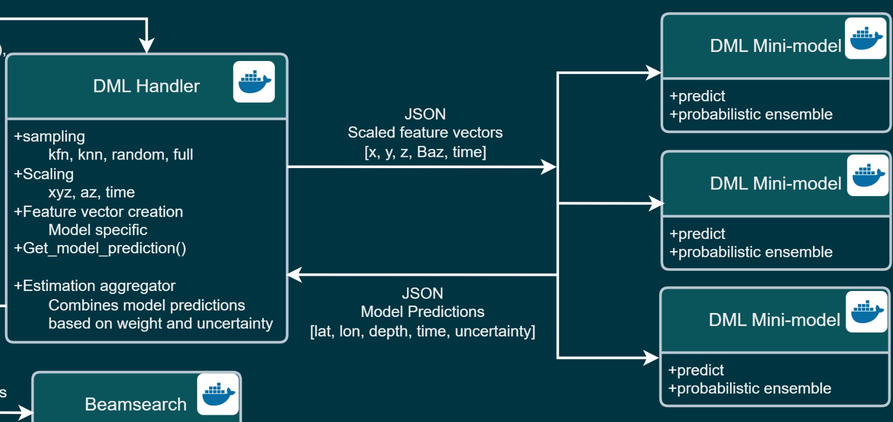
DML Mini-Models
Approach
Perform origin forming on features separately
Location PDF (mean + STD)
Time PDF (mean + STD)
Each feature has a dedicated DML model
We call this a DML mini-model
Inferences PDFs are fused (in the DML handler)
Current mini-models
P-wave arrival
S-wave arrival
Back azimuth

Slide 17
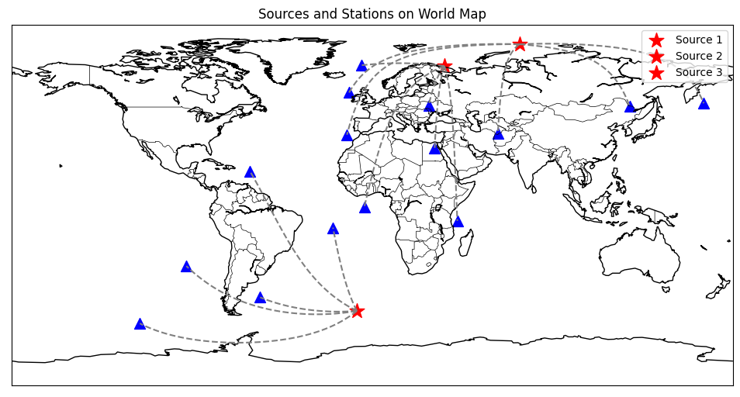
DML Mini-Models
Each mini-model
Requires 5 stations
Uses one station (at ransom) as the anchor station, time zero reference
Geo references using X,Y,Z scaled
Trained on large scale synthetic data azimuth

Slide 18
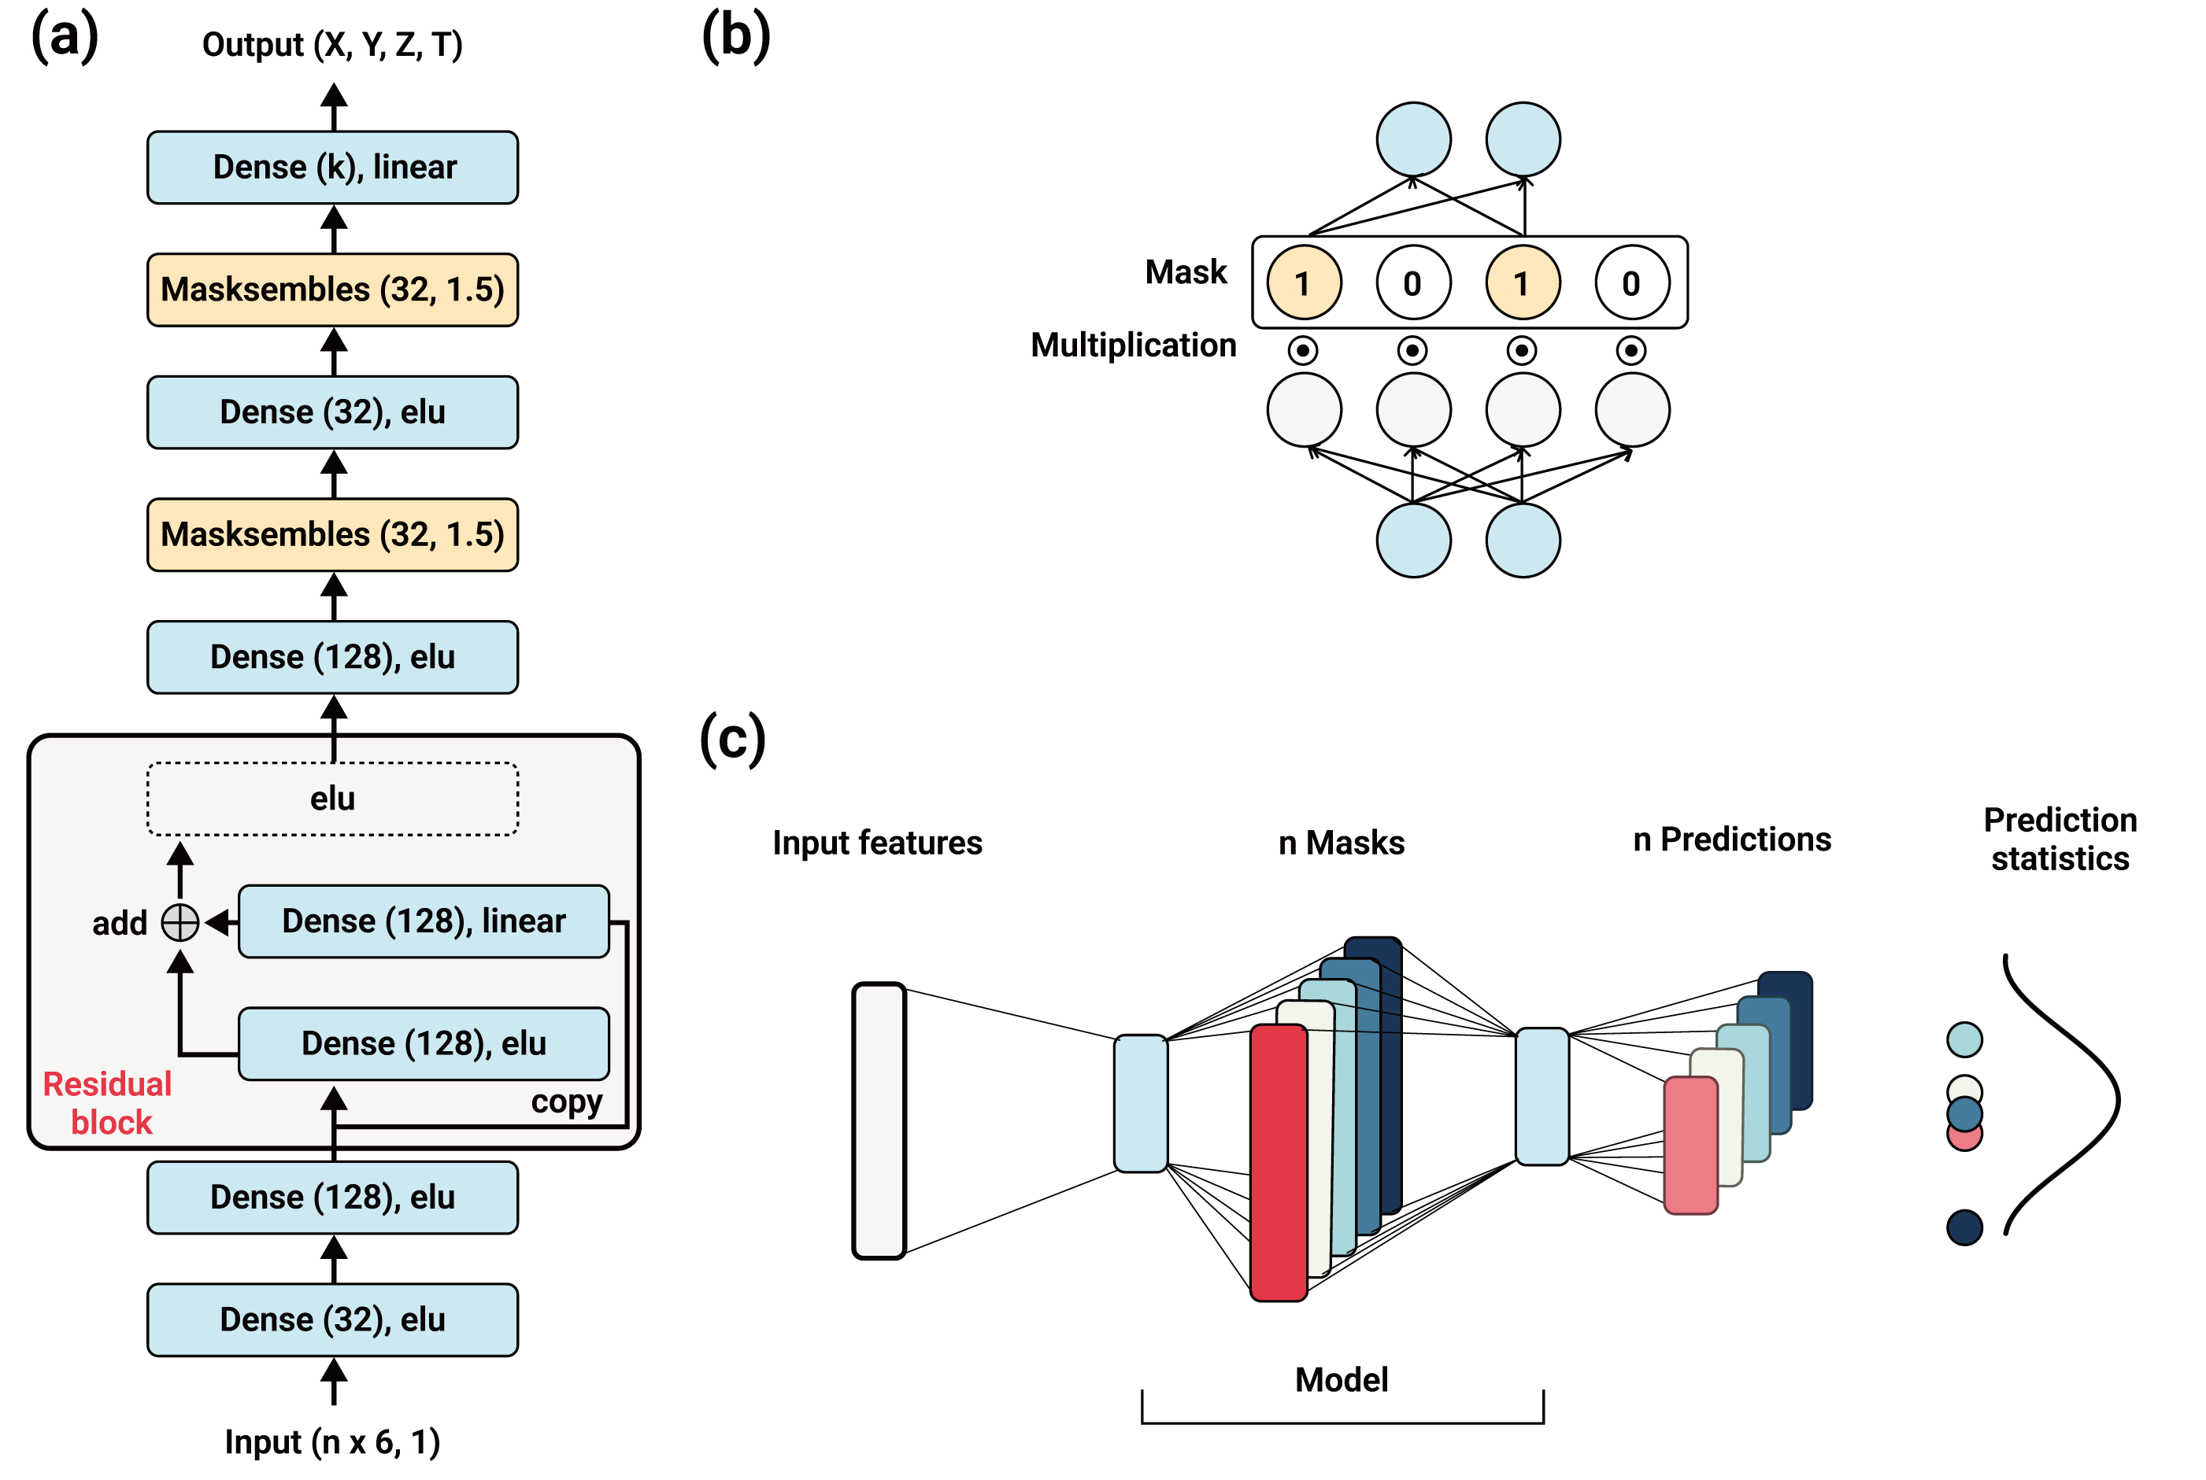
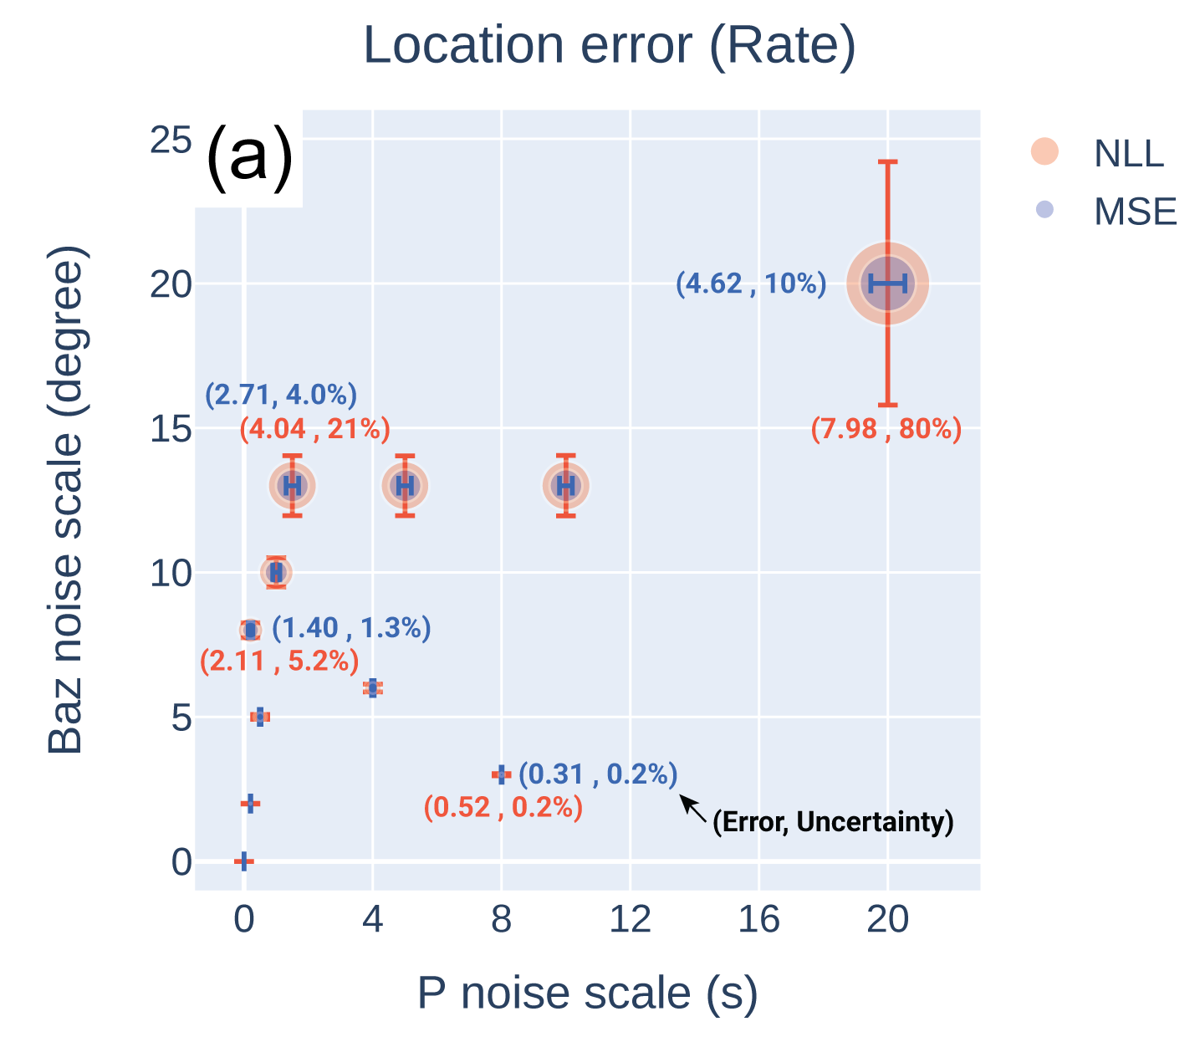
DML Mini-Models
Each mini-model
Requires 5 stations
Uses one station (at ransom) as the anchor station, time zero reference
Geo references using X,Y,Z scaled
Trained on large scale synthetic data
Incorporates Masksembles to generate statistical
Generates 128 predictions per inference
Back azimuth

Slide 19
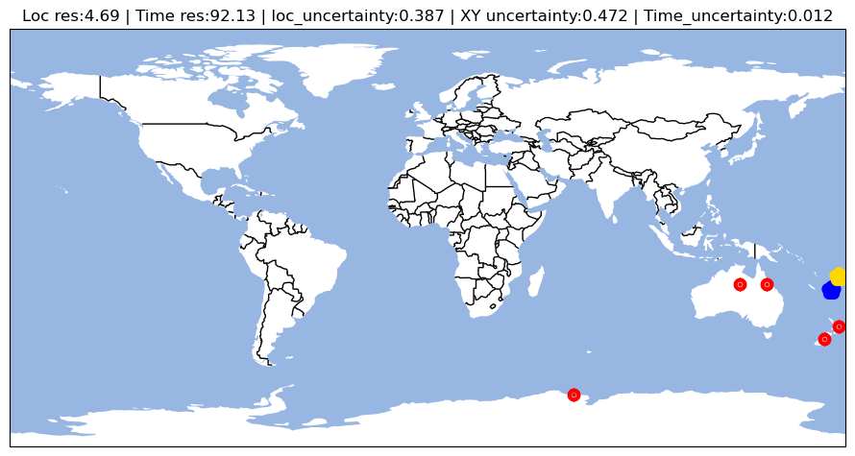
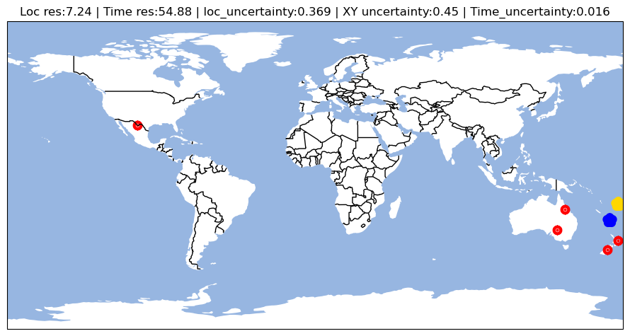
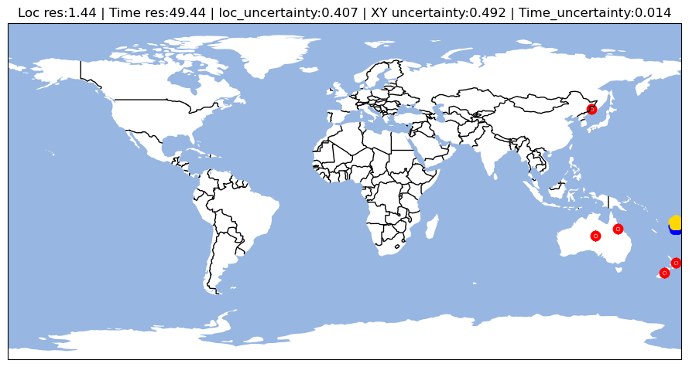
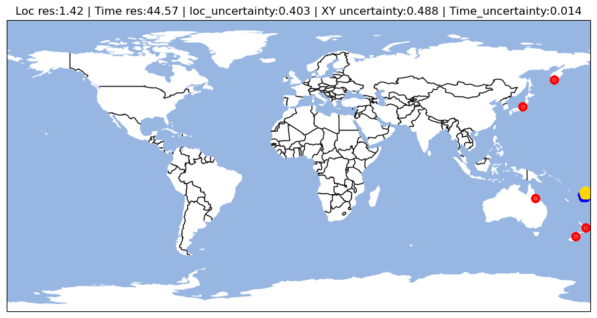
DML Mini-Models: UGEB Testing
P-wave arrival mini-model example: Same source different station combinations
Prediction
Source
Station

Slide 20
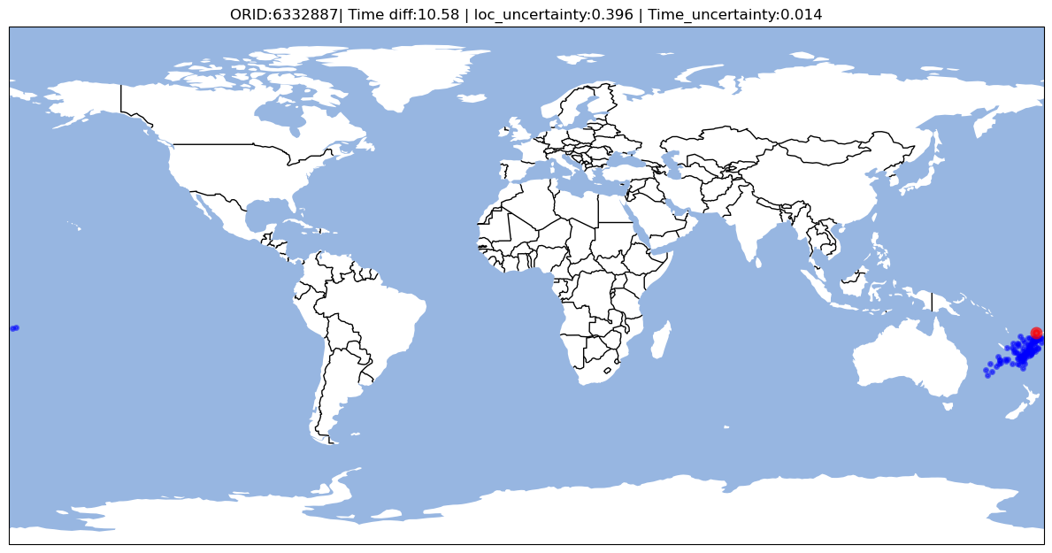
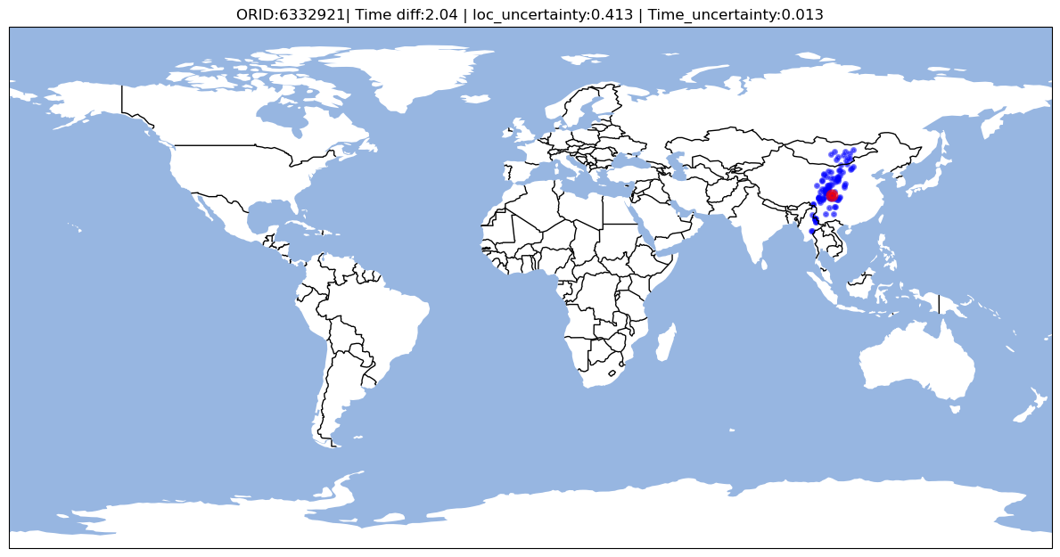
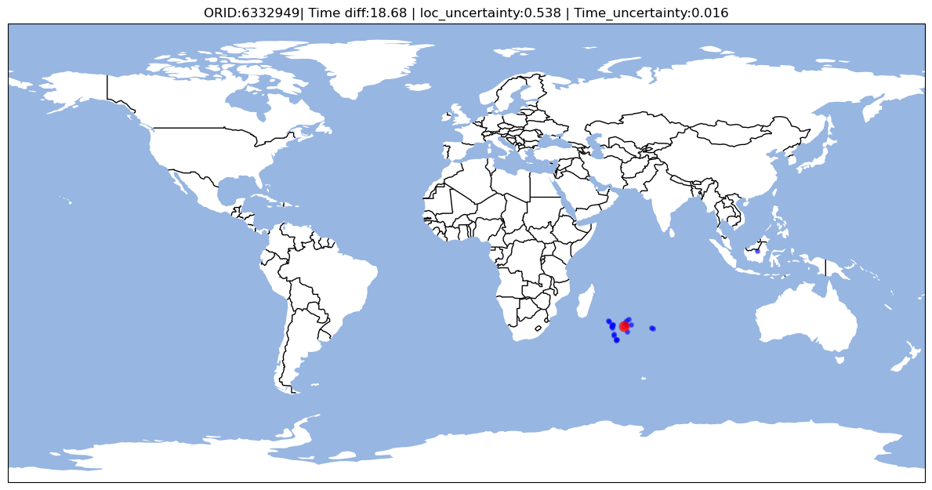
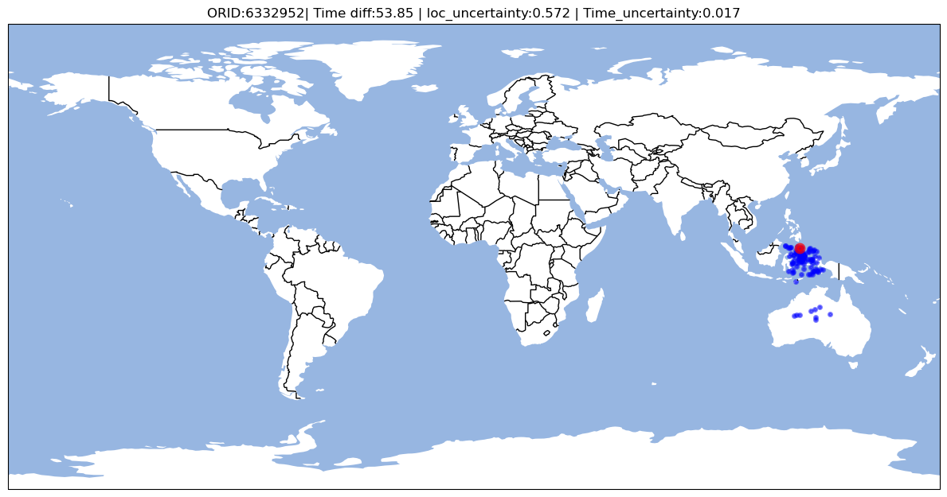
DML Mini-Models: UGEB Testing
P-wave arrival mini-model example: Same source different station combinations

Slide 21
DML Mini-Models: UGEB Testing
P-wave arrival mini-model example: Same source different station combinations
Overall P-wave Performance
Mean origin time error
38.8 seconds
Mean origin location error
4.3 degrees

Slide 22
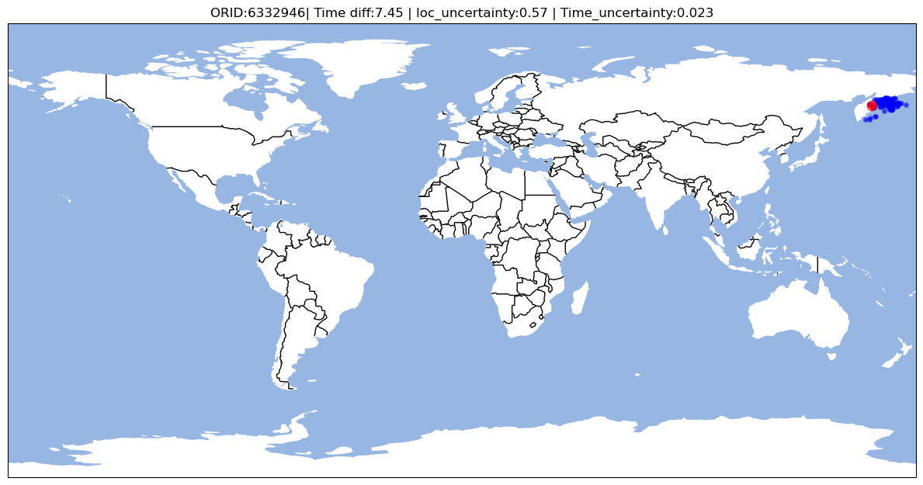
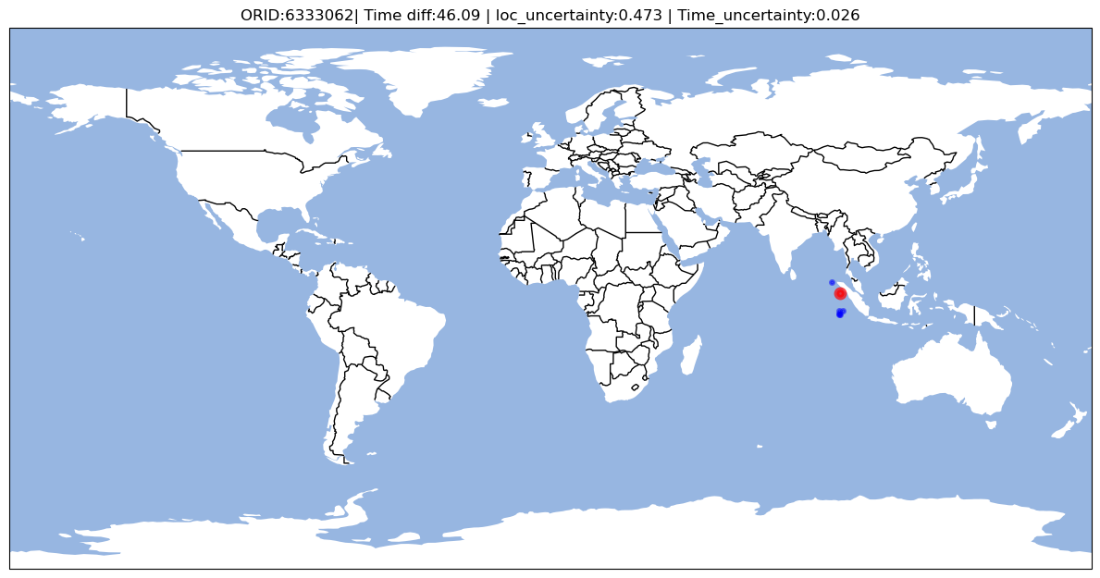


DML Mini-Models: UGEB Testing
Back azimuth mini-model example: Same source different station combinations
Overall Back az Performance
Mean origin time error
52.2 seconds
Mean origin location error
5.2 degrees

Slide 23
DML Handler
Preprocessing
Station/arrival sampling
knn, kfn, random, full
Scaling feature
Preparing feature vectors for each mini-model
Postprocessing
Fuses multiple (feature-based) inferences

Slide 24
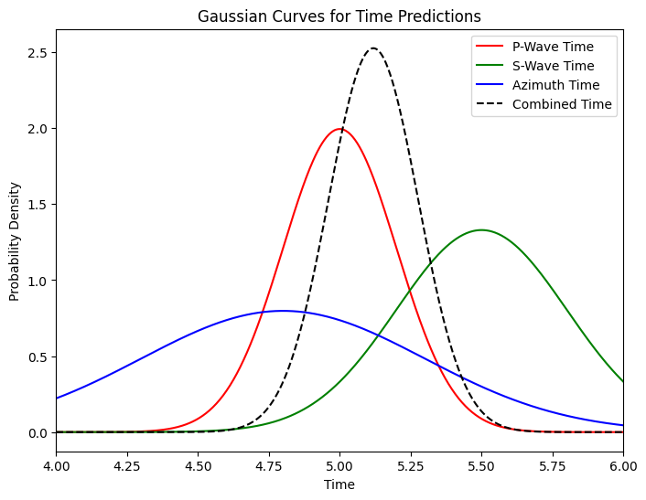
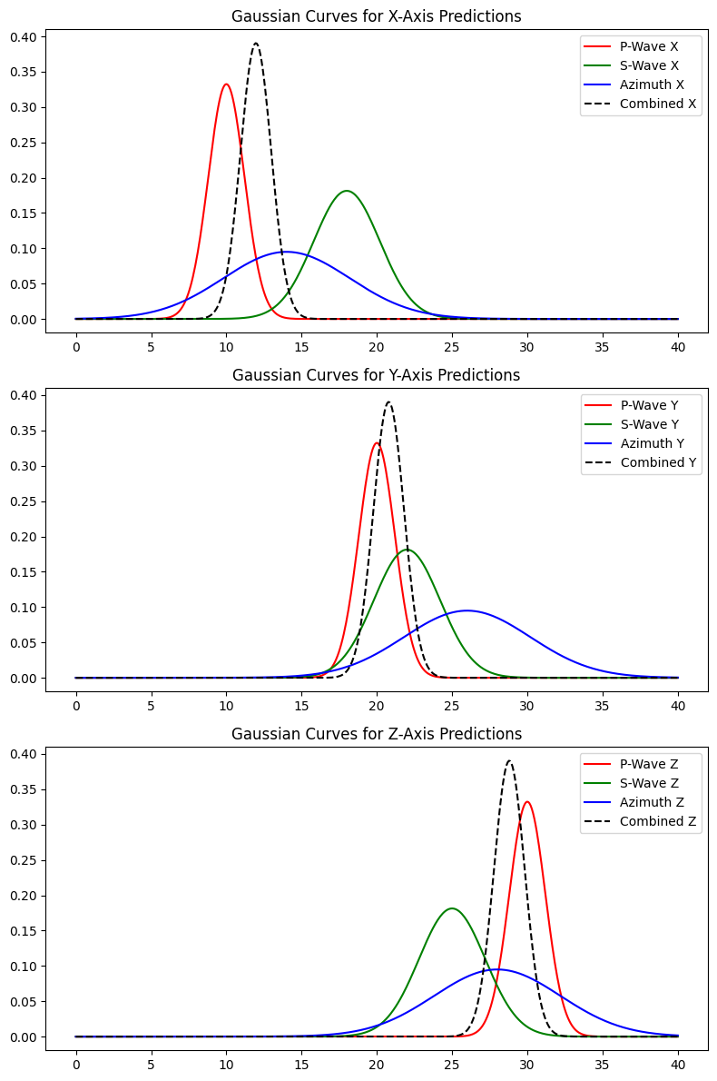

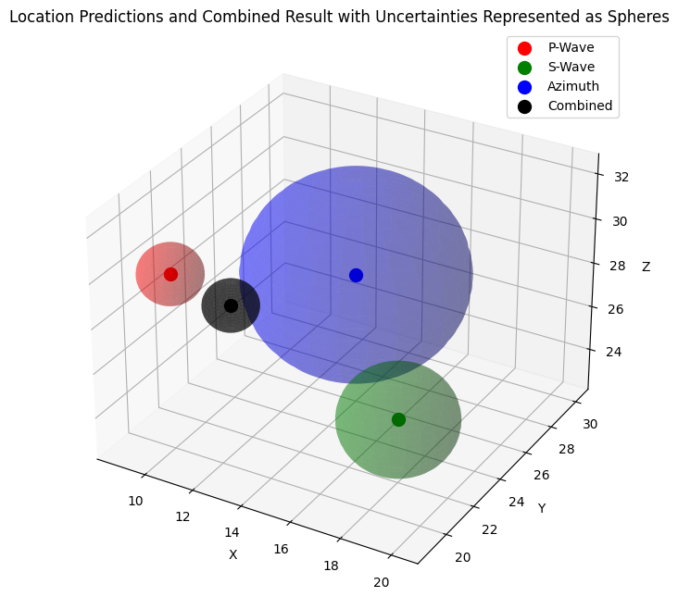
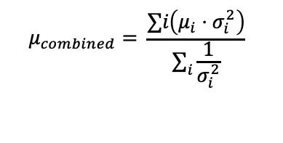
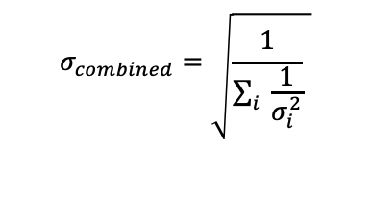
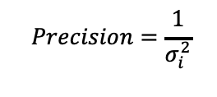
Fusing DML-MM Inferences
Mini-models predictions
Described by a gaussian representation
Bayesian update
Predictions are combined weighted by precision
Combine result
Combine mean: weighted average of predictions
Combine uncertainty: Single uncertainty value based on total precision

Slide 25
Beam Search
Objectives
Origin refinement
Event pruning and merging
Preliminary association

Slide 26
Beam Search
Beam Preparation
Beam Search
Load DML Predictions (pred_results, arid_pool)
Run DML on the New Combinations
Prepare Initial Beam List
(Beams with top scores)
Update Beams by adding arrivals (prediction scores)
Sort Beams by Stations (higher probability matters)
Prune Beams to Top K
Based on Their Scores
New
Combinations
Update the Arid Pool
(Remove repeating stations)
Update the Arid Pool
(Remove repeating stations)
Generate all possible combinations by Arid Pool
Generate all possible combinations by Arid Pool
No New Combinations
Merge Beams
(time & distance control)
OcTree grid search inliner count optimization

Slide 27
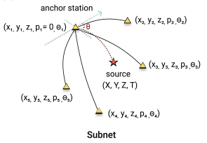
Beam Search
Prediction
Time (t)
Beam Preparation
pred_results
Uncertainty
Location (x, y, z)
Load DML Predictions (pred_results, arid_pool)
arid_pool (Unassigned arrivals)
Prepare Initial Beam List
(Beams with top scores)
Each Beam [Arrival A, B, C, D, E]
A
E
Sort Beams by Stations (higher probability matters)
Prediction
Update the Arid Pool
(Remove repeating stations)
D
Generate all possible combinations by Arid Pool
B
C

Slide 28
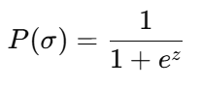
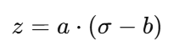
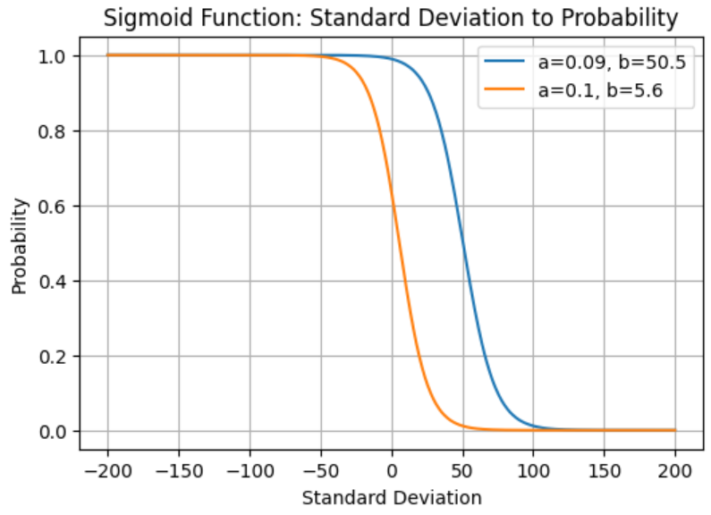
Beam Search
Standard Deviation (σ) to Probability (P)
Beam Preparation
Load DML Predictions (pred_results, arid_pool)
Input: Uncertainty
Prepare Initial Beam List
(Beams with top scores)
Calculate Scores
Sigmoid Function
Output: Scores
Top K Beam
Initial Beam List
Sort Beams by Stations (higher probability matters)
Update the Arid Pool
(Remove repeating stations)
Location
Generate all possible combinations by Arid Pool
Time

Slide 29
Beam Search
Beam Preparation
Beam 1 [E, A, B, C, D]
Load DML Predictions (pred_results, arid_pool)
Beam 2 [E, I, F, G, H]
Prepare Initial Beam List
(Beams with top scores)
Move E to the First
Beam 1 [A, B, C, E, D]
Sort Beams by Stations (higher probability matters)
Count Station Frequency
A
E
Highest-Frequency Station Moves to the First
B
D
Frequency of E is highest!
Update the Arid Pool
(Remove repeating stations)
Remove First Station in arid_pool
C
Beam 2 [I, F, G, H, E]
Generate all possible combinations by Arid Pool
I
F
G
E
H

Slide 30
Beam Search
Beam Preparation
Top 2 beams
arid_pool
Beam 1 [M, A, B, C, D]
Beam 2 [N, A, B, C, D]
Beam 3 [P, A, B, C, D]
Beam 4 [M, I, F, G, H]
Beam 5 [N, I, F, G, H]
Beam 6 [P, I, F, G, H]
Load DML Predictions (pred_results, arid_pool)
Beam 1 [E, A, B, C, D]
Unassigned Station
(M, N, P)
Beam 2 [E, I, F, G, H]
Prepare Initial Beam List
(Beams with top scores)
Sort Beams by Stations (higher probability matters)
+
Update the Arid Pool
(Remove repeating stations)
Generate all possible combinations by Arid Pool
Replace Beam Station with Unassigned Stations in arid_pool

Slide 31
Beam Search
Beam Preparation
Beam Search
Load DML Predictions (pred_results, arid_pool)
Run DML on the New Combinations
New predictions
Source 1
Prepare Initial Beam List
(Beams with top scores)
Update Beams by adding arrivals (prediction scores)
Source 2
Source 3
Sort Beams by Stations (higher probability matters)
Prune Beams to Top K
Based on Their Scores
Source 4
Source 5
Source 6
Update the Arid Pool
(Remove repeating stations)
Update the Arid Pool
(Remove repeating stations)
Generate all possible combinations by Arid Pool
Generate all possible combinations by Arid Pool

Slide 32
Beam Search
Beam Preparation
Beam Search
S1
Load DML Predictions (pred_results, arid_pool)
Run DML on the New Combinations
New predictions
Close
S2
S3
Source 1
M
Prepare Initial Beam List
(Beams with top scores)
Update Beams by adding arrivals (prediction scores)
Source 2
Source 3
S4
Source 4
Close to original
source?
Sort Beams by Stations (higher probability matters)
Prune Beams to Top K
Based on Their Scores
Source 5
Source 6
S5
N
Close
Update the Arid Pool
(Remove repeating stations)
Update the Arid Pool
(Remove repeating stations)
S6
Close
Original good predictions
Source M
Generate all possible combinations by Arid Pool
Generate all possible combinations by Arid Pool
Source N
Add arrivals
Source M
Source N

Slide 33
Beam Search
Beam Preparation
Beam Search
Load DML Predictions (pred_results, arid_pool)
Run DML on the New Combinations
Prepare Initial Beam List
(Beams with top scores)
Update Beams by adding arrivals (prediction scores)
Sort Beams by Stations (higher probability matters)
Prune Beams to Top K
Based on Their Scores
K Events Saved (K=2 Here)
Source N
Update the Arid Pool
(Remove repeating stations)
Update the Arid Pool
(Remove repeating stations)
Remove Associated Stations
Source M
arid_pool
Generate all possible combinations by Arid Pool
Generate all possible combinations by Arid Pool
Source N
arid_pool

Slide 34
Beam Search
Beam Preparation
Beam Search
Load DML Predictions (pred_results, arid_pool)
Run DML on the New Combinations
Prepare Initial Beam List
(Beams with top scores)
Update Beams by adding arrivals (prediction scores)
New
Combinations
Source M
+
Sort Beams by Stations (higher probability matters)
Prune Beams to Top K
Based on Their Scores
Update the Arid Pool
(Remove repeating stations)
Update the Arid Pool
(Remove repeating stations)
Source N
+
Generate all possible combinations by Arid Pool
Replace Beam Station with Unassigned Stations in arid_pool
Generate all possible combinations by Arid Pool
OcTree grid search inliner count optimization
No New Combinations
M
Merge
Long beams
Merge Beams
(time & distance control)
Origin time contrast < 200s
N
Source location contrast < 600km

Slide 35
Future Work: Octree
Octree development
Create surrogates for each feature
DL model for fast execution
Update in-liner function to fuse contributing features
Dockerize
Create API
Structure input and output JSON
Test, refine, …

Slide 36
Future Work: Benchmarking & Metrics
Association benchmarking
Data
Data to associate: IDCX
Target: UGEB
Metric to beat: SEL3
Dataset periods: 5/15/2010 – 5/29/2010
UGEB period

Slide 37
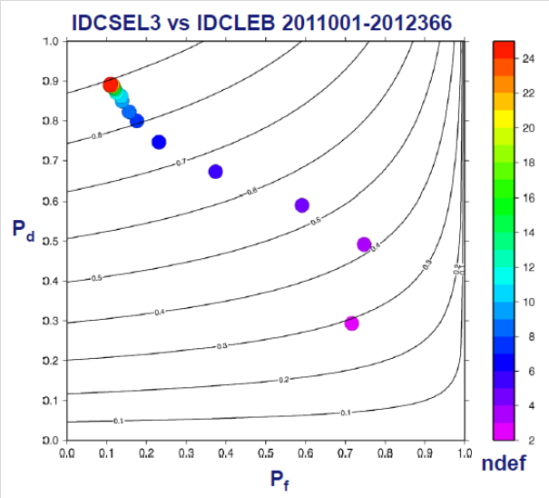
Future Work: Benchmarking & Metrics
Association benchmarking
Data
Data to associate: IDCX
Target: UGEB
Metric to beat: SEL3
Dataset periods: 5/15/2010 – 5/29/2010
UGEB period
Benchmarking
Using AFTAC (Brian’s) BullComp
Nominally event-based
Previously we have presented phase-based approaches
Metrics
Event commonality
Bulletin quality (Q)
P_{d}: Probability of event detection
P_{f}: Probability of false event

Slide 38

Thanks
Actionable Intelligence through Analytics

